Slide 1
A PICTURE OF TRUTH
“
”
Ηυ Λανσηυανγ
2017.11.14

Slide 2
About the topic
<The Mythe of Factive Verbs> 2010 <Factive Presupposition and theTruth Condition on Knowledge> 2012

Slide 3
About the topic
1.Is being true a kind of warrant?
2.what the relationship between truth and factivity?
3.Does the truth need epstimic warrant ?IF so what's the different between between truth and knowledge?
4.Is true a real character of a propostion OR it speaks nothing ,just a kind of presupposition?
5.Is TRUTH play the same role in 'KNOW' and 'KNOWLEDGE'?
what is truth?

Slide 4
CRISPIN WRIGHT
<Truth: A Traditional DebateReviewed>
1
truth-bearer
2
truth theories reviewed
3
Thinking and Answers

Slide 5
Truth-bearer
1

Slide 6
Truth-bearer
1
proposition
sentence :
statement :
judgment :
assertion:
utterence

Slide 7
Truth-bearer
1
abvrjoef;oijskcdcjdbscsbc,kbjkdlsjbslkj
judgment
express
a b c
actions......

Slide 8
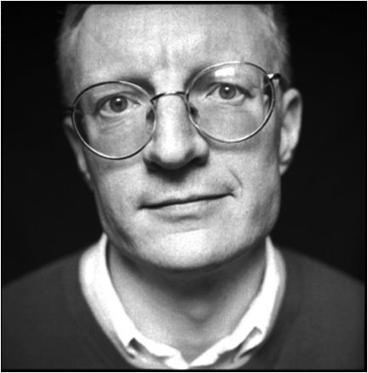
Truth-bearer
1
propositions is the truth-bearers, sentence is derived truth-bearers
utterances is the truth-bearers not the propositions
(0) u says that P
(1)Not:either u is true or u is false
(2a)u is true if and only if P
(2b)u is fals if and only if not P
(3)not (P or notP)
(4)notP and not not P
I agree that :
are truth-bearers

Slide 9
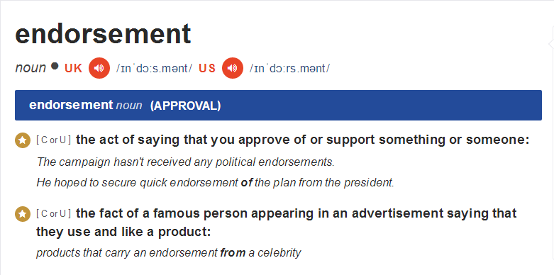
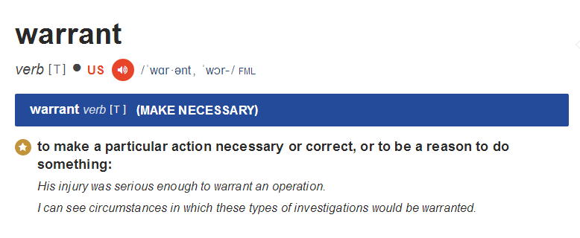

Slide 10
2
Truth theory reviewed
2.1 Introduction
Correspondence theory holds that truth is a relational characteristic whose terms are respectively propositions and non-propositional items in an independent world.
Coherence theory agrees about the relationality of truth, but the truth of a proposition consists not in a relation to something non-propositional but in its participation in a system, meeting certain conditions, whose other participants are likewise propositions - so ultimately in relations to those other propositions.

Slide 11
2
2
Truth theory reviewed
2.1 Introduction
That truth is, broadly, a matter of operational success of some kind- while making no clear suggestion about structure stands in opposition to the correspondence theorists' thoughts about objectivity without intentionally anyway implying anything like such idealism.
that truth allows of no analysis, because it is too simple, or primitive, or because any notions involved in a formulation which is at least correct will rapidly bring one back to truth, so compromising illumination.

Slide 12
2
2
Truth theory reviewed
Truth theory reviewed
2.1 Introduction
That truth is an intrinsic propetry of particular proposition.
There simply isn't anything which truth, in general, is. It's a misconstrual of the role of the adjective "true" to see it as expressing the concept of a substantial characteristic of which one of the traditional accounts might provide a correct analysis, or which might allow of no correct analysis.

Slide 13
2
2
Truth theory reviewed
2.1 Introduction
Not a genuine characteristic
An intrinsic(non- relational) characteristic
A truth-bearer's truth is
with other propositions
A genuine characteristic
An relational characteristic
with non-propositional world

Slide 14
2
Truth theory reviewed
2.2 OBJECTIONS AND DEFENCE
Objections to intrinsicism
If its truth-value were an intrinsic property of a particular proposition, then no contingent change in any other object should entail change in the proposition in that particular respect.By this simple test truth is, manifestly, not an intrinsic property. For the truth-value of any contingent proposition must covary with hypothetical changes in the characteristics of things it concerns - so that a hypothetical change, for instance, in the location of my coffee cup may entail an alteration in the truth-value of the proposition that there is no coffee cup on my desk, even though that proposition and the particular coffee cup in question are quite distinct existences. It is clearly that intrinsicism cannot handle the general run of contingent cases.

Slide 15
2
Truth theory reviewed
2.2 OBJECTIONS AND DEFENCE
Objections to deflationism
INTRODUCTION
Deflationism is more of a "tendency" than a definite philosophical position, and different deflationists display differences of formulation and emphasis which make it hard to see what may be essential and what optional in their views. There are, however, a number of characteristic, inter-related claims:
There is no property of truth which is an appropriate object of philosophical attention: something which we might try to analyze, or in whose structure we might be interested, or which might give rise to issues about objectivity. Contrary to the presupposition both of the traditional debate and of its revision canvassed above, there is nothing in which the truth of a proposition, e.g., consists. "True" expresses no real property.
1.

Slide 16
2
Truth theory reviewed
2.2 OBJECTIONS AND DEFENCE
Objections to deflationism
"true" is just the device of disquotation- a device for affirming at the metalinguistic level exactly what can be affirmed at the object-language level by an assertoric use of "P"
Disquotational Schemeis is a complete explanation of the meaning of "true"
"P" is true  p,
(or if the primary grammar of "true" is considered to be that of an operator on propositions.Equivalence Schema-It is true that P /that P is true if and only if P)

Slide 17
2
Truth theory reviewed
2.2 OBJECTIONS AND DEFENCE
Objections to deflationism
"true" is just a device of endorsement- we only have any use for such a term because we sometimes choose to endorse true propositions indirectly, without specifying their content and sometimes want to endorse whole batches of propositions at once. In other kinds of case we can dispense with the word altogether.
4.
Endorsement generally involves an element of recommendation, or approval of an item as meeting a certain standard.

Slide 18
2
Truth theory reviewed
2.2 OBJECTIONS AND DEFENCE
Objections to deflationism
YES,'true' is similar with warrant.
If “truth“ is a device of endorsing propositions as compliying with some norms?
NOT constant with “Equivalence Schema”
NO,'true' is distinct from warrant.
Then,what do you mean by “ assertoric use of p”
It means that………………
This question turn out to be not very illuminating or nontrivial.
It is a term registers a distinctive norm over a practicehis .
It IS a kind of characteristic
Frege's Indefinabilism
This presumption ought to be that there will be something in which a move's compliance or non-compliance with norms . And that will then be a real characteristic of the move.

Slide 19
2
Truth theory reviewed
2.2 OBJECTIONS AND DEFENCE
Objections to deflationism
(1) It is true that PP
(2)It is true that not-P not P
(3)It is not true that PnotP
(4)It is not true that P if and only if it is true that not-P
if 'true' is similar with warrant,then(4)means
It is not the case that P is warranted if and only if it is the case that not-P is warranted.

Slide 20
2
Truth theory reviewed
2.2 OBJECTIONS AND DEFENCE
Deflationism's possible defence
Equivalence Schema- is that "true" is so used as to call for - express - a norm over the acceptance of propositions which is distinct from warrant. It's quite another matter whether there really is such a norm -whether there really is such a way for a proposition to be in, or out, of good standing. It's one thing for an expression to be used in the making of a certain distinctive kind of normative claim; quite another matter for there to be such a thing as a bearer's really qualifying for a judgment of that kind.

Slide 21
2
Truth theory reviewed
2.2 OBJECTIONS AND DEFENCE
Anti-defence
It is easily seen that deflationism cannot avail itself of any counterpart of this first line of defence. For the deflationist must surely be quite content to allow that all manner of statements really are true-when the right circumstances obtain: that grass is green, for instance, really is true just when grass is green; that snow is white really is true just when snow is white,and so on. For deflationism, there has to be, for each proposition- or at least for those of an objective subject matter- an objective condition., For equivalence Schema.It is not merely that our concept of truth calls for such a norm; the call is answered.

Slide 22
2
Truth theory reviewed
2.2 OBJECTIONS AND DEFENCE
Deflationism's possible defence
Truth is no single property.Many properties are such that their satisfaction conditiond vary as a fuction of the character of a potential bearer.In general, how x has to be in order to be F can depend in part on how things stand in other respects with x, and vary accordingly, a general condition which being F involves satisfying.
(1)The property of having fuliilled one's educational potential.
(2)The property of being twice as old as one's oldest child.
“this without any analysis or understanding of a common property of truth, the idea that there is such a thing is an illusion”
-----------Blackburn,
Spreading the Word (Oxford: Oxford University Press, 1984), 230-31.

Slide 23
2
Introduction of the article
2.2 OBJECTIONS AND DEFENCE
Anti-defence
There is accordingly no comfort for a deflationist in the platitude that how things have to be in order for particular propositions to be true varies. Propositions vary in how they claim matters to stand - as parents vary in how old their children are, or people vary in what their educational potential is - and propositions' truth-values will naturally be a function of the specific such claims they make.
To impose the rubric explicitly: for any proposition p, it is true that p just in case there is a way things could be such that anyone who believed, doubted, that things were that way, and things are that way.
Then ,It is a kind of property.

Slide 24
2
Truth theory reviewed
2.2 OBJECTIONS AND DEFENCE
Deflationism's possible defence
A sympathizer with deflationism may think that although inconsistent with the traditional formulations of deflationism, is still nothing terribly at odds with its spirit. Maybe it has to be recognized that truth is a property after all, contrasting with justification, and normative over assertion and belief. But the conviction of the traditional debate is that it is a metaphysically deep property, whose essence is unobvious and controversial. By contrast, the characterization of it now offered by way of rebuttal of the tendency of Blackburn's remarks is nothing if not obvious and trivial; The victory over deflationism is therefore Pyrrhic: the skirmishing has led us to say what truth in general is in such a way as to drain all metaphysical interest from the question.

Slide 25
2
Truth theory reviewed
2.2 OBJECTIONS AND DEFENCE
Anti-defence
Anyone who has mastered the concept of truth and does not scruple to quantify over "ways things could be" can accept it as necessary and sufficient for the truth of a proposition that there be a way things could be which anyone who believes that proposition will suppose realized, and which is indeed realized. To accept that much enjoins so far no commitment on the matter of what kind of characteristic relational the truth of a proposition is, nor on whether or to what extent its possession may be viewed as objective. Exactly those are the metaphysically substantial matters.

Slide 26
1
2
Truth theory reviewed
2.2 OBJECTIONS AND DEFENCE
Objections to coherence
The coherence theory cannot discriminate truth from falsehood,and it can not justify the principles like (non-contradition):
if p is true,not-p is not true.
yes ,then,participation insuch a system is clearly insufficient for thruth .
If fiction can constitude such a system
No ,then,it appears that truth is not constituted purely in inter-proposition relations---the propositions in question have to meet some other conditions.

Slide 27
2
Truth theory reviewed
2.2 OBJECTIONS AND DEFENCE
Coherentism's possible defence
First, we can go relativist, conceding that there is indeed no absolute truth, and embracing the contention that, to the contrary, truth is relative to the system.Principles, like non-contradiction, which seem to require that the truth cannot extend to every conceivable coherent system of propositions, are misconstrued when taken to have that implication. Sure, they are valid within systems: no proposition can participate in a coherent system for which its negation is already a member. But they have no valid application across systems.
Anti-defence
This kind of truth is so weak ,and bring many bad influences.

Slide 28
2
Truth theory reviewed
2.2 OBJECTIONS AND DEFENCE
Coherentism's possible defence
Alternatively,we can avoid unappealing form of relativism by earmarking certain propositions as in some way privileged, and construing truth not as participation in any old sufficiently comprehensive, coherent system of propositions, but as participation in such a system which is irequired include the privileged propositions. That means we can choose a dominate system ,and chonerence with it consititutes truth.
Anti-defence
This resources may be available to do so if the you chooses the privileged base class cannily and interprets the relation of coherence in some correspondingly suitable way.so,can you exiplian what do you mean by saying that a proposition coherence with other propositions

Slide 29
2
Truth theory reviewed
2.2 OBJECTIONS AND DEFENCE
Coherentism's possible defence
The conherence relation is simply consistency.On this view, to say that a proposition coheres with a specified set of propositions is to say that the proposition is consistent with the set.
Anti-defence
This account of coherence is unsatisfactory for the following reason. Consider two propositions which do not belong to a specified set. These propositions could both be consistent with a specified set and yet be inconsistent with each other. If coherence is consistency, the coherence theorist would have to claim that both propositions are true, but this is impossible.

Slide 30
2
Truth theory reviewed
2.2 OBJECTIONS AND DEFENCE
Coherentism's possible defence
NO,the coherence relation is some form of entailment. Entailment can be understood here as strict logical entailment, or entailment in some looser sense. According to this version, a proposition coheres with a set of propositions if and only if it is entailed by members of the set. Another more plausible version of the theory, is that coherence is mutual explanatory support between propositions.
Anti-defence
May be that's right ,but two questions. Fist, what if a proposition and it's negation both can not be entailed by members of the set ?Second ,if coherenence relation means entailment ,then every proposition's truth-value is well determined,how do you deal with contingent?

Slide 31
2
Truth theory reviewed
2.2 OBJECTIONS AND DEFENCE
Coherentism's possible defence
For the fist question ,we a choose maximally coherent and comprehensive system as the dominate system.For the second question , what contingency demands is flexibility in the matter of dominance.For example ,Dominance might be interpreted just as a matter of incorporating lots of what we actually believe, and its flexibility would then be secured by the flexibility in the identity of our beliefs.
Anti-defence
Maximally coherent and comprehensive system is the things that only some idealists seem to accept it. And on the other hand the theory can not deal with the truth-value of this kind of proposition:
(K）'S is dominate.'

Slide 32
2
Truth theory reviewed
2.2OBJECTIONS AND DEFENCE
Correspondence theory of truth
We are squarely committed to a correspondence,but two very important qualifications are needed immediately.
First,It merits emphasis that even if the effect of the foregoing arguments is indeed to impose a conception of truth as conferred on a proposition by aspects of non-propositional reality,that conclusion certainly carries no direct implications for the realism debate in its modern conception.In particular, nothing is implied about cognitivism - about whether the factors in-volved in appraising truth are invariably wholly cognitive- nor about evidential constraint - about whether it is possible for truth to outrun all evidence available in principle.
Second,there ought in any case, I believe, to be no presumption in favour of a monistic view of truth.If the difficulties which we have been exploring are to dispose of all the alternatives to correspondence once and for all, then it needs to be assumed that truth everywhere must possess a uniform constitution: that the truth of any true proposition always consists in the same sort of thing. Yet why should that be so?

Slide 33
3
Thinking and Anwsers
Correspondence may be not sufficient but definitely necessary.
T：X is true if and only if p
Tarsik: satisfication
Logic truth in first order logic:inclusion relation
Deflationism: (1) matters are like what it express.
(2)assertoric use of p in object-language
Coherence : entaild by other specific propositions in a dominate system.
ALL，Directly or indirectly connect with the non-proposition world.

Slide 34
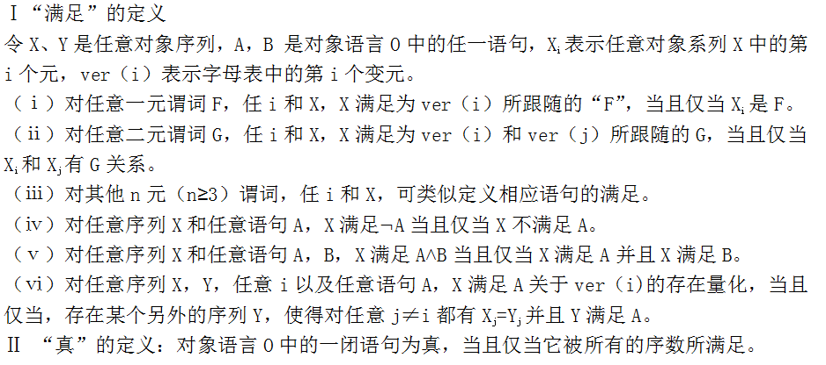
3
Thinking and Anwsers
Tarsik:

Slide 35
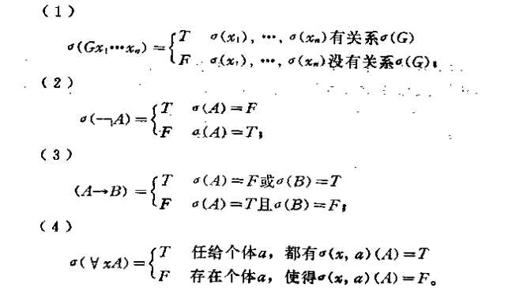
3
Thinking and Anwsers
Logic truth in first order logic:inclusion relation
<(x1)，……（xn)>G

Slide 36
3
Thinking and Anwsers
proposition world
non-proposition world
satisfication
inclusion relation
TRUTH
superasserterment
disquotation
................
Correspondence

Slide 37
3
Thinking and Anwsers
Correspondence can not solve the problems,couse it can not deal the proposition 's truth-value whose content is about another proposition(sentence).
'what's your name'is a question.
question is a sentence or phrase use to find out information.
'what's your name 'is a sentence to find out information of one's name.
'what's your name 'is a question

Slide 38
3
Thinking and Anwsers
We can in favour a plurastic view of truth that the truth of any true proposition needn't always consists in thing.
truth propositions' systems
Abstract rules or contracts
TRUTH
True proposition1
True proposition2
……
ptopositions

Slide 39
3
Thinking and Anwsers
We can in favour a plurastic view of truth that the truth of any true proposition needn't always consists in thing.
propositions
p means have good relations with following three situations
(1)p is correspondence with non-proposition world.
(2)p is a correspondence with abstract rules or contracts
(3)p is coherence with the system which consist of the from (1) (2)
T：“P” is true if and only if p

Slide 40
thank you

